Slide 1
Tla+
by Amlan Gupta
amlangup@buffalo.edu

Slide 2
Leslie Lamport
2013 A.M. Turing Award Winner
IEEE Emanuel R. Piore Award
IEEE John von Neumann Medal
Lamport's bakery algorithm
Byzantine fault tolerance
Paxos algorithm
Lamport signature
Chandy-Lamport algorithm
One of the most cited author in computer science history

Slide 3
Agenda
How to write TLA+ specs
TLA Model Checker
PlusCal Translator

Slide 4
TLA+ Specs

Slide 5
What is TLA+
TLA+ is a language for modeling concurrent and distributed system above the code level and hardware above the circuit level. TLA+ is based on mathematics and does not resemble any programming language. Most engineers will find PlusCal, to be the easiest way to start using TLA+.
Some important tools TLA+ has:
TLC Model Checker
TLAPS, the TLA+ proof system
TLA+ Toolbox, an IDE
PlusCal Translator

Slide 6
What is TLA+
TLA+ uses a model checker to examine the execution trace for violations of properties:
Uses set theory to specify Safety properties, i.e., that bad things won't happen. Also called invariants.
Uses temporal logic to define Liveness properties, i.e., that good things eventually happen.
Invariant based reasoning avoids the complexities and bugs of operational reasoning (happy path ) for concurrent system. Operational reasoning does not scale well.

Slide 7
Abstraction
Simplifying a concept by removing details
Abstraction is most important part of engineering
It lets us understand complex systems
The hard part of learning to write TLA+ specs is learning to think abstractly about the system.
- Brannon Batson, former intel engineer

Slide 8
Basic Abstraction underlying TLA+
An execution of a system is represented as a sequence of discrete steps.
Discrete: we can abstract its continuous evolution as a sequence of discrete events.
Sequence: We can simulate a concurrent system with a sequential program.
Step: TLA+ describes a step as a state change.

Slide 9
Introducing State Machines
A state is an assignment of values to variables, so a state machine is described by:
What the variables are.
Possible initial values of variables.
A relation between their values in the current state and their possible values in the next state.

Slide 10
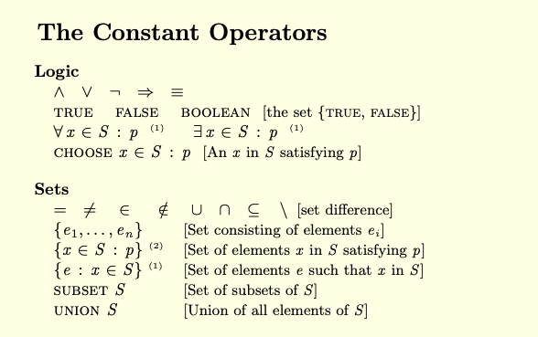

Slide 11
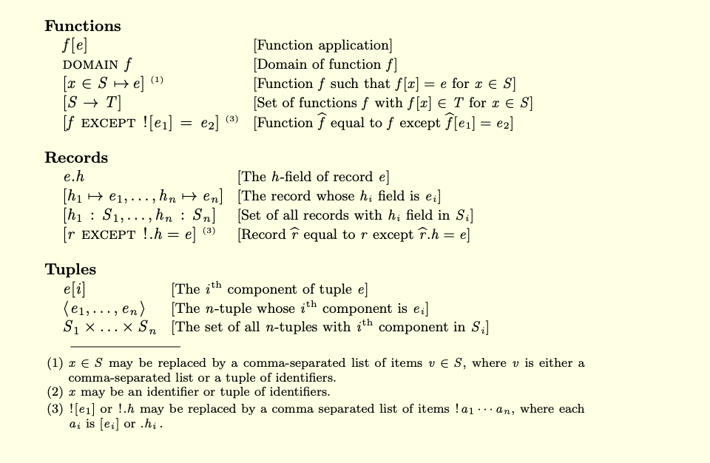

Slide 12
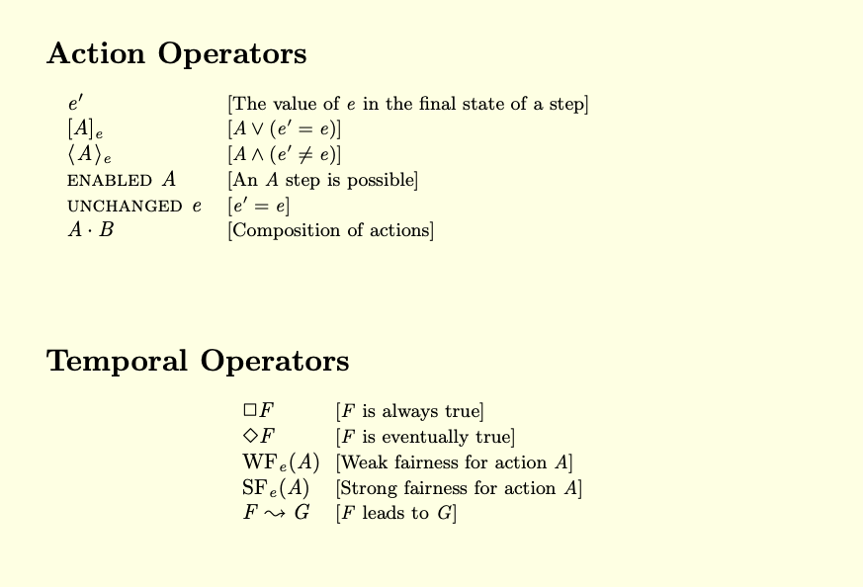

Slide 13
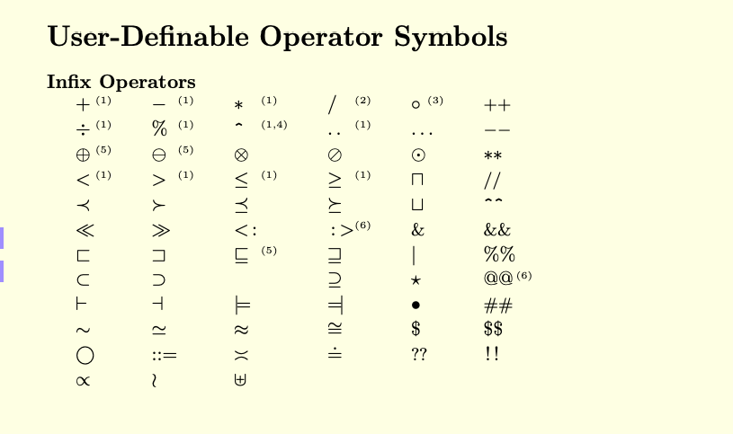

Slide 14
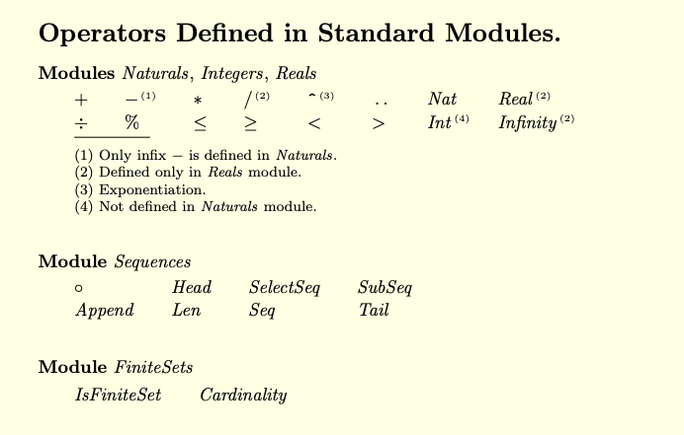

Slide 15
A Trivial Example
Sample C Program
int i ;
void main() {
i = someNumber () ;
i = i + 1 ;
}
A logical Representation
if current value of pc equals “start”
then next value of i in {0, 1, . . . , 1000}
next value of pc equals “middle”
else if current value of pc equals “middle”
then next value of i equals
current value of i + 1
next value of pc equals “done”
else no next values
pc → process control

Slide 16
A Trivial Example
if current value of pc equals “start”
then next value of i in {0, 1, . . . , 1000}
next value of pc equals “middle”
else if current value of pc equals “middle”
then next value of i equals current value of i + 1
next value of pc equals “done”
else no next values
Next value of i → i’
Equals → =

Slide 17
A Trivial Example
if pc =“start”
then i’ in {0, 1, . . . , 1000}
pc’ = “middle”
else if pc’ = “middle”
then i’ = i + 1
pc’ = “done”
else no next values
∈
0..1000

Slide 18
A Trivial Example
if pc =“start”
then i’ ∈ 0..1000
pc’ = “middle”
else if pc’ = “middle”
then i’ =i + 1
pc’ = “done”
else no next values
^
FALSE

Slide 19
A Trivial Example
IF pc =“start”
THEN (i’ ∈ 0..1000) ∧
(pc’ = “middle”)
ELSE IF pc’ = “middle”
THEN (i’ = i + 1) ∧
(pc’ = “done”)
ELSE FALSE
A
B

Slide 20
A Trivial Example
IF pc =“start”
THEN A
ELSE IF pc’ = “middle”
THEN B
ELSE FALSE
(pc =“start”) ∧ A
∨
(pc’ =“middle”) ∧ B

Slide 21
A Trivial Example
((pc =“start”)
∧ (i’ ∈ 0..1000)
∧ (pc’ = “middle”))
∨ ((pc’ =“middle”)
∧ (i’ = i + 1)
∧ (pc’ = “done”))
(pc =“start”) ∧ A
∨ (pc’ =“middle”) ∧ B

Slide 22
A Trivial Example
∧ pc =“start”
∧ i’ ∈ 0..1000
∧ pc’ = “middle”
∨ ∧ pc’ =“middle”
∧ i’ = i + 1
∧ pc’ = “done”
((pc =“start”)
∧ (i’ ∈ 0..1000)
∧ (pc’ = “middle”))
∨ ((pc’ =“middle”)
∧ (i’ = i + 1)
∧ (pc’ = “done”))
∨

Slide 23
The Complete Specification
Initial-state formula:
(i = 0) ∧ (pc = “start”)
Next-state formula:
∨∧ pc = “start”
∧ i’ ∈ 0..1000
∧ pc’ = “middle”
∨∧ pc’ = “middle”
∧ i’ = i + 1
∧ pc’ = “done”

Slide 24
What is TLA+ Toolbox
The TLA Toolbox is an IDE (integrated development environment) for the TLA+ tools.
Create and edit your specs, with the locations of parsing errors marked in the modules.
Run the PlusCal translator, with the locations of translation errors marked in the PlusCal code.
View the pretty-printed versions of your modules.
Run the TLC model checker. The Toolbox allows you to explorer an error trace produced by TLC—for example, by evaluating arbitrary formulas at each step in the trace.
Run the TLAPS

Slide 25
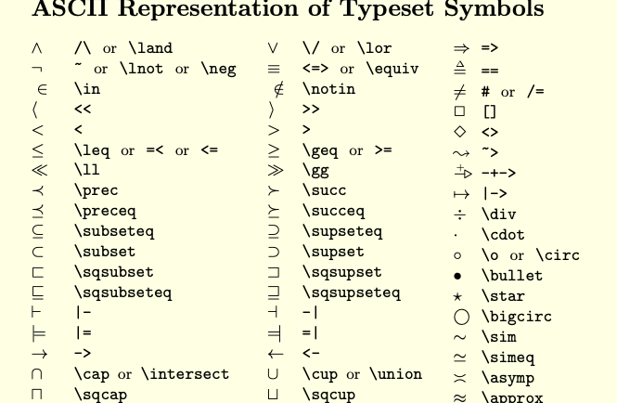
Note: neque digni and in aliquet nisl et a umis varius.

Slide 26
Die Hard Problem
Heroes have to put exactly 4 gallons of water in a Jug to stop a bomb from going off. But they have only 2 containers:
Big Jug – 5 Gallons
Small Jug– 3 Gallons
It is possible to pour water from one jug to another.

Slide 27
Variables and Steps
Small: 0
Big: 0
Small: 3
Big: 0
Small: 0
Big: 3
Small: 3
Big: 3
Small: 3
Big: 1
Small: 0
Big: 1
Small: 1
Big: 0
Small: 1
Big: 5
Small: 0
Big: 4
Small: 3
Big: 4
Small: 3
Big: 0
….

Slide 28
Die Hard DEMO
Model checking results
Type Correctness
Invariant
Error Trace Exploration

Slide 29
Let’s Review Other Operator and Modules

Slide 30
Temporal Logic
TLA allows reasoning about sequence of states
A temporal formula is built from elementary formulas using Boolean operators and unary operators [ ] and <>
For example [] F, <>F, ¬ F, F ∧ G, F ∨G
Eventually: <> F = ¬ [] ¬ F
Eventually Always: <>[]F
Leads to: F ↝ G ≡ [](F ⇒ <>G)

Slide 31
Alternating Bit protocol

Slide 32
A
B
Carrol
Bob
Alice
Carrol
Bob
Alice
AVar
BVar
Alice
Bob
Carrol

Slide 33
A
B
Carrol, 0
Carrol, 0
Carrol, 1
Bob, 0
Alice, 1
Carrol, 1
Bob, 0
Alice, 1
AVar
BVar
Alice
Bob
Carrol
Carrol

Slide 34
AB Specification
TypeOK = ∧ AVar ∈ Data × { 0, 1}
∧ BVar ∈ Data × { 0, 1}
Init = ∧ AVar ∈ Data × {1}
∧ BVar = AVar
∈

Slide 35
AB Specification
When A sends a message
A = ∧ AVar = BVar
∧ ∃ d ∈ Data : AVar’ = < d, 1 - AVar[2]>
∧ BVar’ = Bvar
When B updates it’s message
B = ∧ AVar ≠ BVar
∧ BVar’ = Avar
∧ AVar’ = AVar
Next = A ∨ B
Spec = Init ∧ [] [Next]_{vars}

Slide 36
AB Specification
Spec = Init ∧ [] [Next]_{vars}
Safety formula asserts what may happen , so this can be described as such
It fails if the Init is false
Or the [Next]_{vars} is false in some steps, which means the step neither satisfies Next nor leaves vars unchanged

Slide 37
AB Specification
Liveness formula asserts what must happen
(AVar = <“hello”,0>) ↝ (BVar = <“hello”,0>)
General Form:
∀v ∈ Data × { 0, 1}: (AVar = v) ↝ (BVar = v)

Slide 38
PlusCal
Formal Speciation Language

Slide 39
PlusCal
PlusCal (formerly called +CAL) is a formal specification language
It transpiles to TLA+
It was designed to replace pseudocode, retaining its simplicity while providing a formally-defined and verifiable language.
PlusCal has two separate syntaxes:
Prolix p-syntax
More compact c-syntax

Slide 40
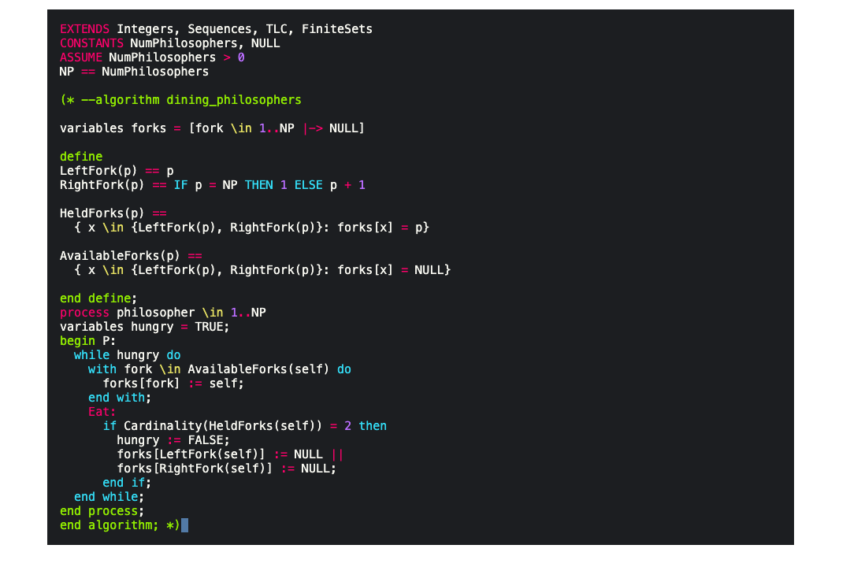

Slide 41
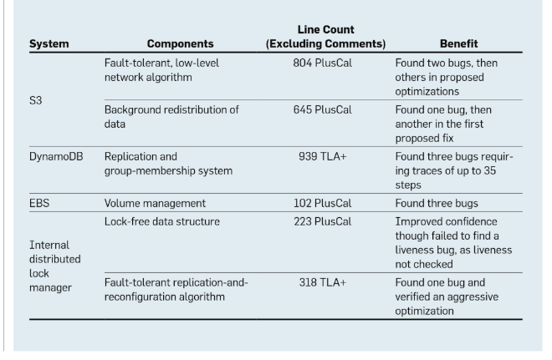
Note: neque digni and in aliquet nisl et a umis varius.

Slide 42
Experience using TLA+
An Amazon Engineer says:
“In order to safeguard data we rely on the correctness of an ever-growing set of algorithms for replication, consistency, concurrency-control, fault tolerance, auto-scaling, and other coordination activities.”
Microsoft Engineer say:
“Writing a TLA+ spec caught a bug that would not otherwise have been found. That bug would have caused every Xbox 360 to crash after 4 hours of use.”

Slide 43
Reference
http://lamport.azurewebsites.net/
https://slideplayer.com/slide/5077454/
https://learntla.com/

Slide 44
Thank You

